Slide 1

Software Engineering
Gruppo 9 – Drawing App
Lorenzo Mignone - 0622701866
Artemis Ostadimitris - 0622701874
Gaetano Parolise - 0622701919
Davide Parente - 0622701859

Slide 2
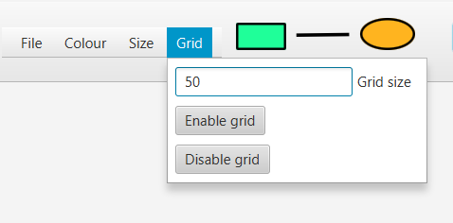
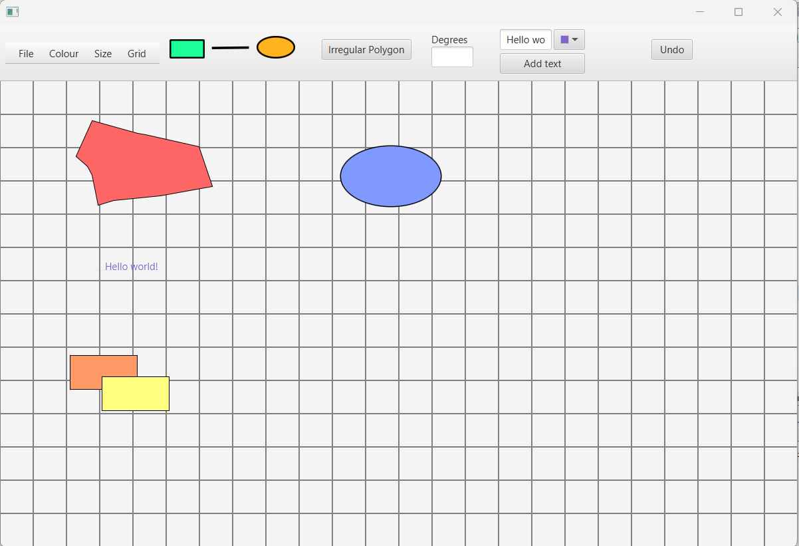
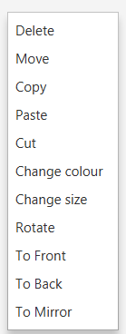
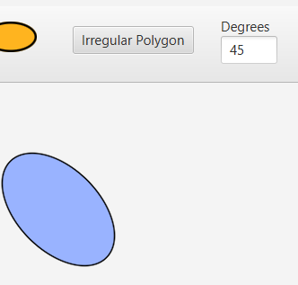
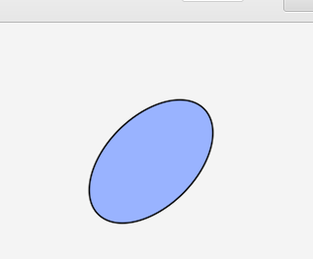
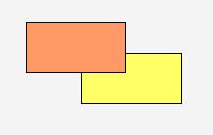
Sprint 3 - Release
Achieved goals:
Layering function
Scroll bars
Grid
Zoom function
Rotate function
Creation of text shapes
Creation of irregular polygons
Rotation of 45 degrees
Mirroring
To front of the orange rectangle

Slide 3
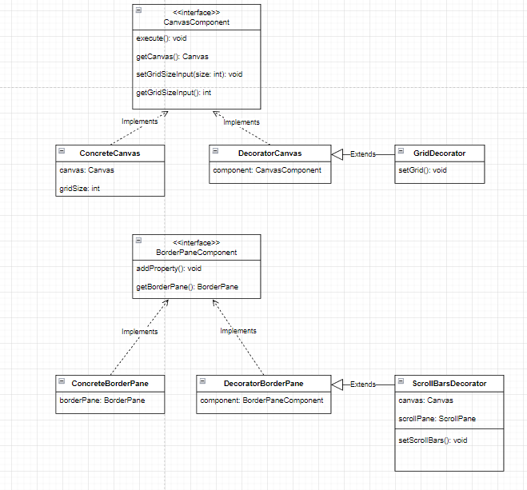
Patterns used – Decorator

Slide 4
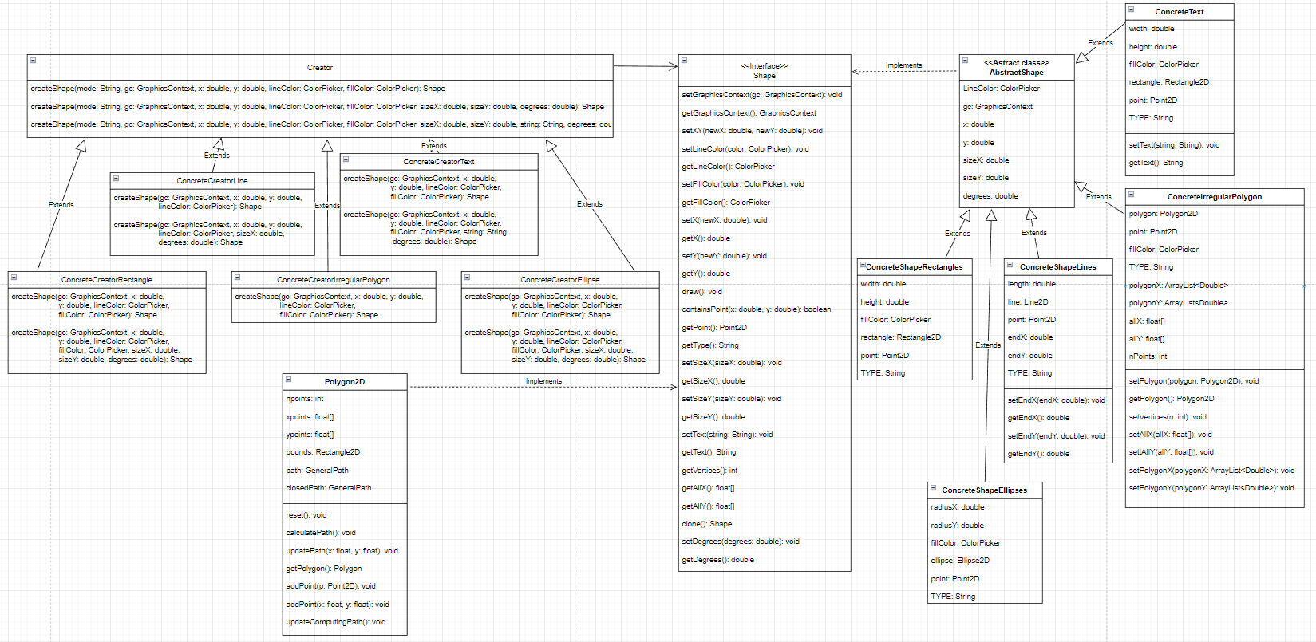
Patterns used – Factory Method

Slide 5
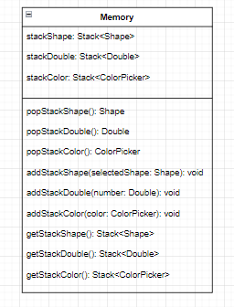
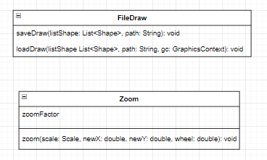
Package Functions
Package Memory

Slide 6
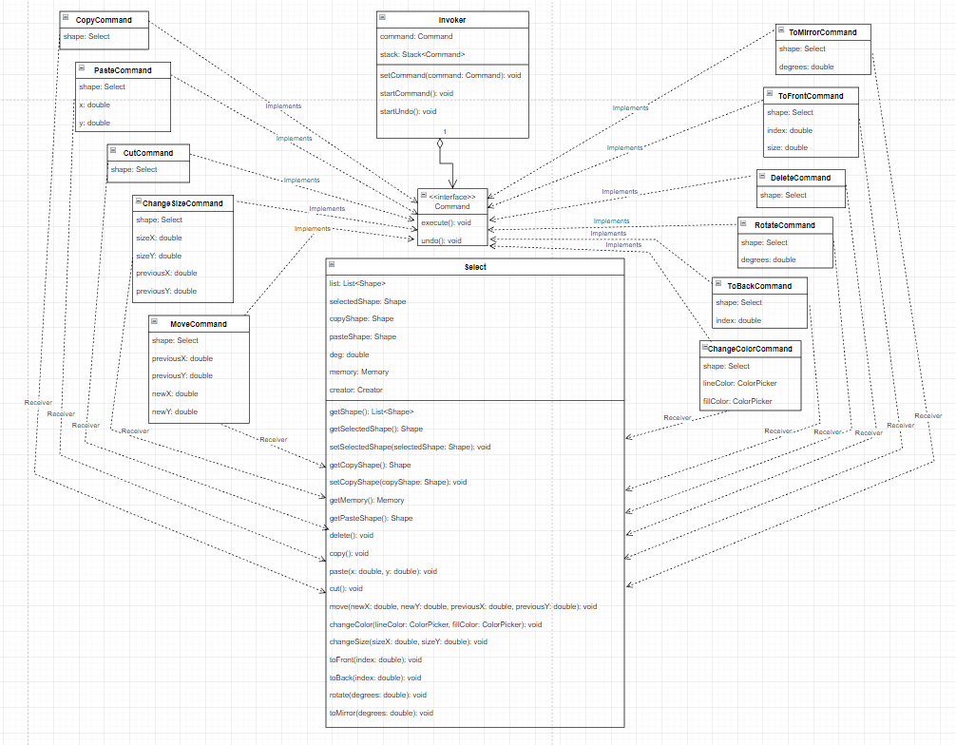
Patterns used – Command

Slide 7

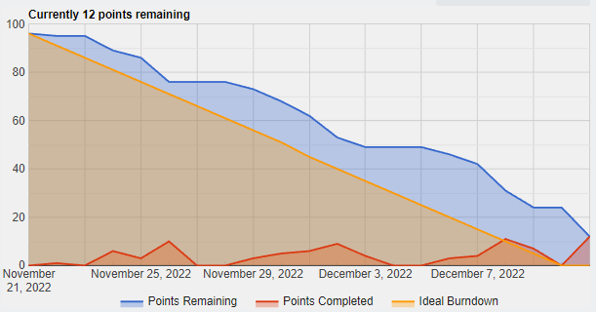

Sprint Review
Team velocity
Estimated a priori velocity: 49 SP
Estimated retrospectively velocity: 37 SP
Operation of change size cannot be performed on text shapes and irregular polygons
Operation of move cannot be performed on irregular polygons
Problems detected

Slide 8
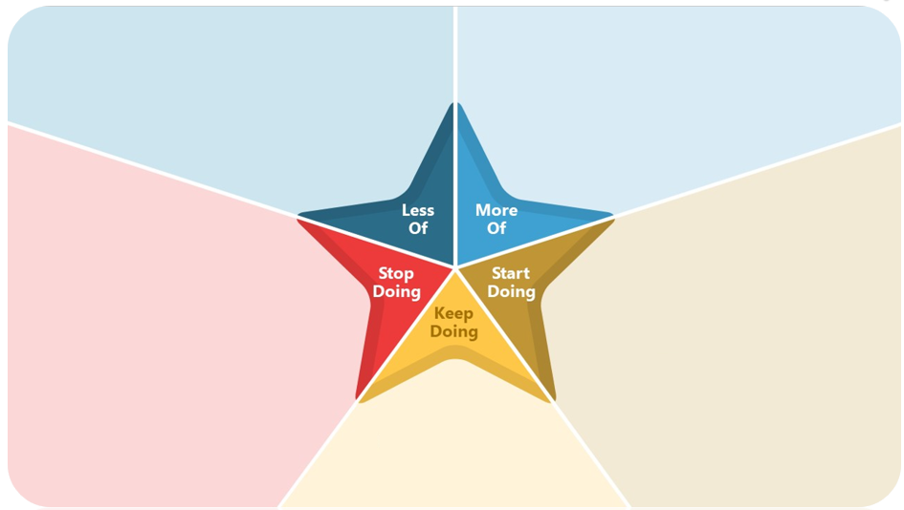
Retrospective
Nothing
Nothing
Nothing
Nothing
Continue doing meetings
Continue doing code review by all members
Raise issues during daily meetings
Comment out code

